Slide 1
Energy Ponds – pitch March 31st, 2020
By Krzysztof Wasniewski

Slide 2
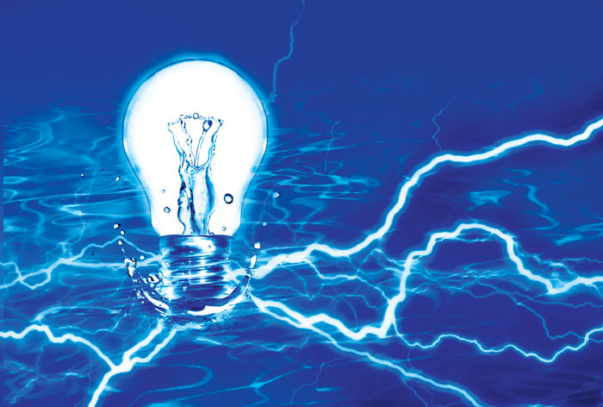
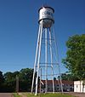
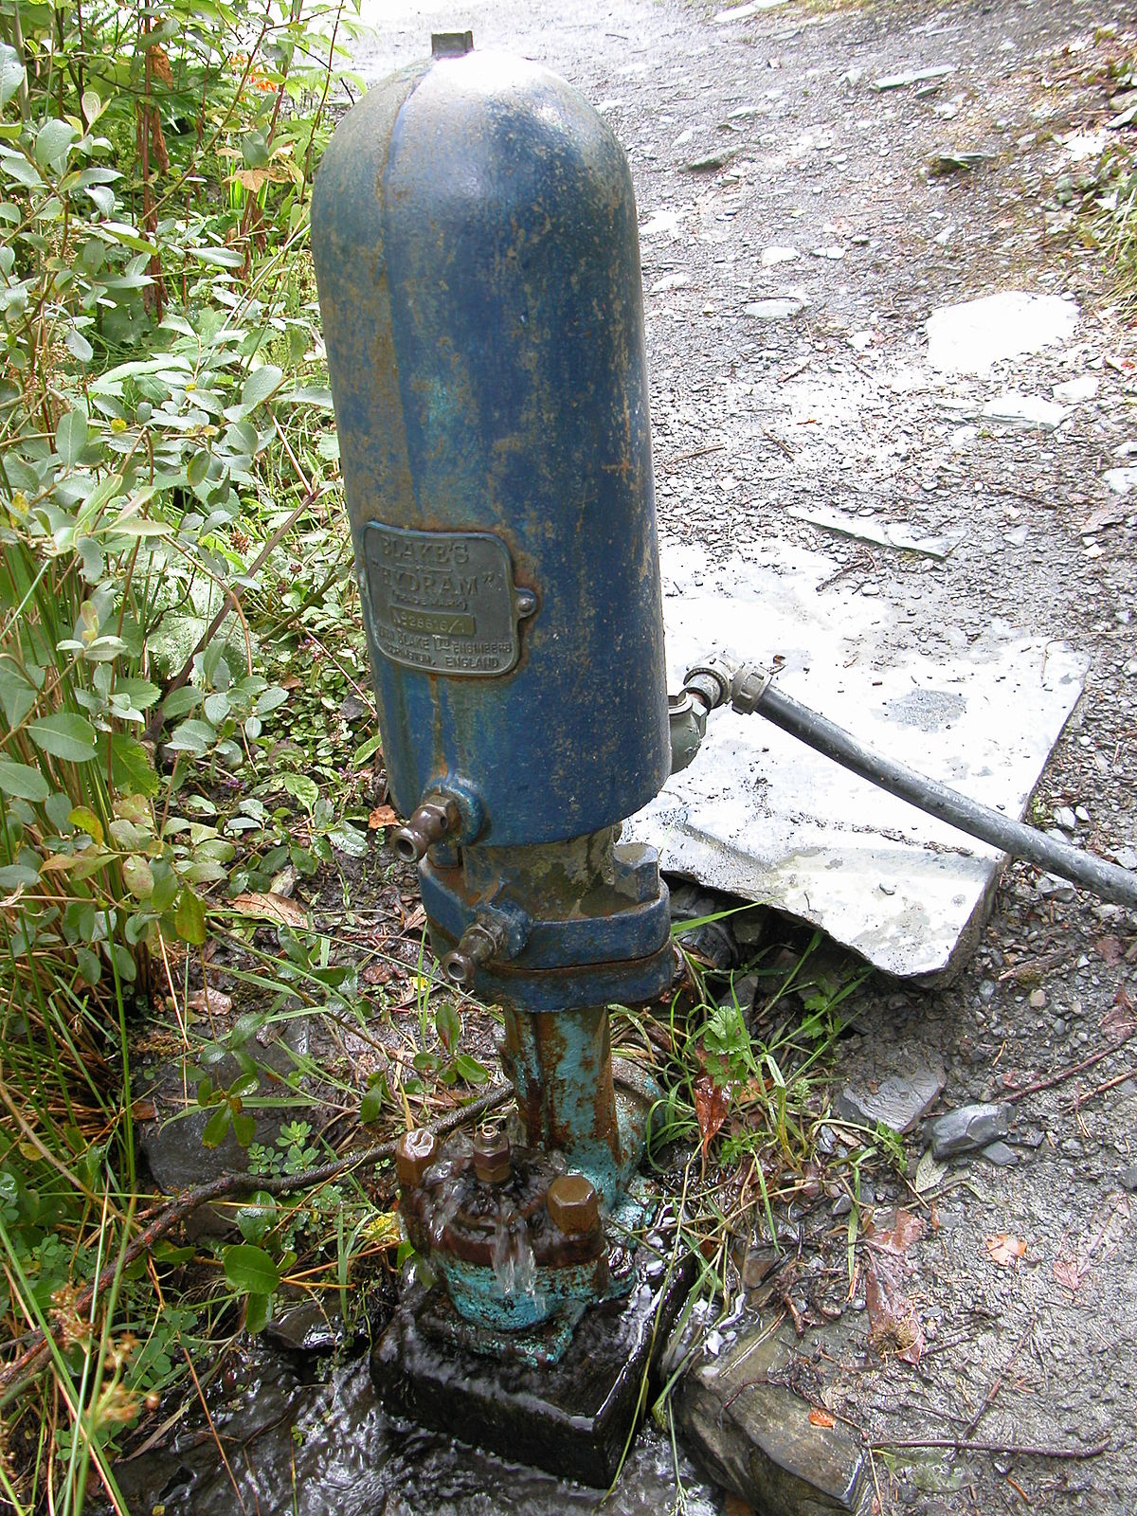
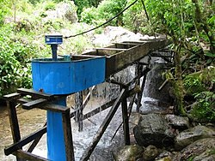
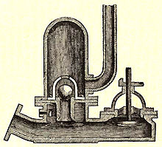
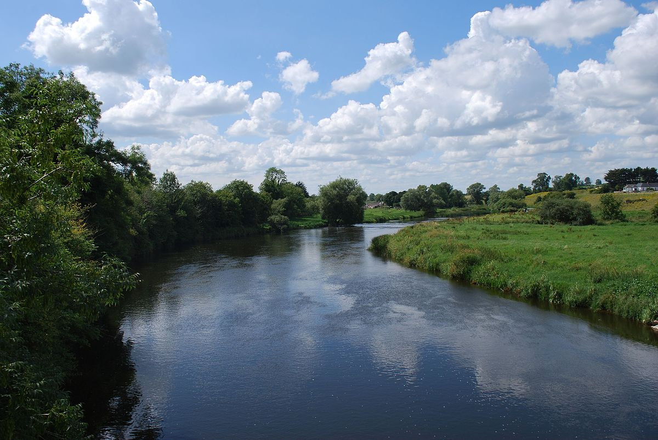
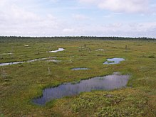
The essential concept of Energy Ponds
OUTPUT OF ELECTRICITY
ELEVATED TANK
hydraulic head passes through water turbines
RAM PUMPS
RIVER
WETLANDS
With time, water from wetlands…
…gets drained back into the river

Slide 3
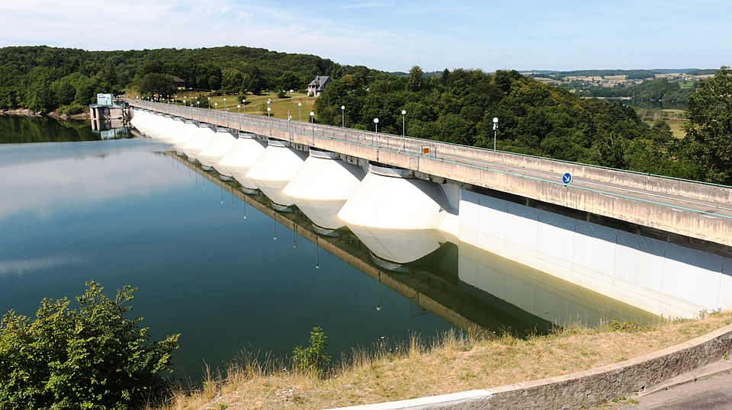
Wetlands vs big retention reservoirs
Large retention reservoirs
Wetlands
Only big capacity and big investment outlays make sense
Significant intrusion into land management
Significant environmental impact
Highly scalable capacity and size
Natural hydrological processes save capital
Practically impossible to create against natural environmental conditions

Slide 4
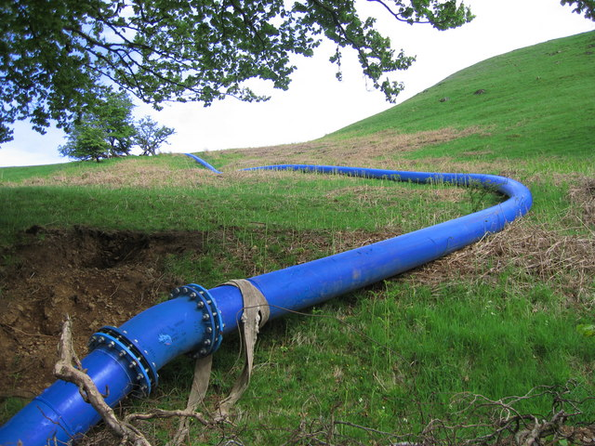
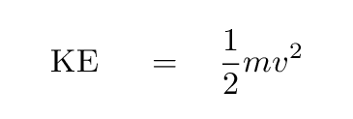
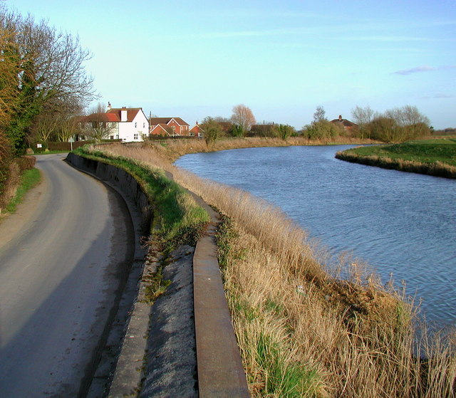
Big rivers, with significant flow per second, are largely embanked, and those embankments protect against floods, whilst they are an obstacle to natural formation of wetlands.
Some sort of pumping technology is necessary to bypass the embankments
RAM PUMPS

Slide 5
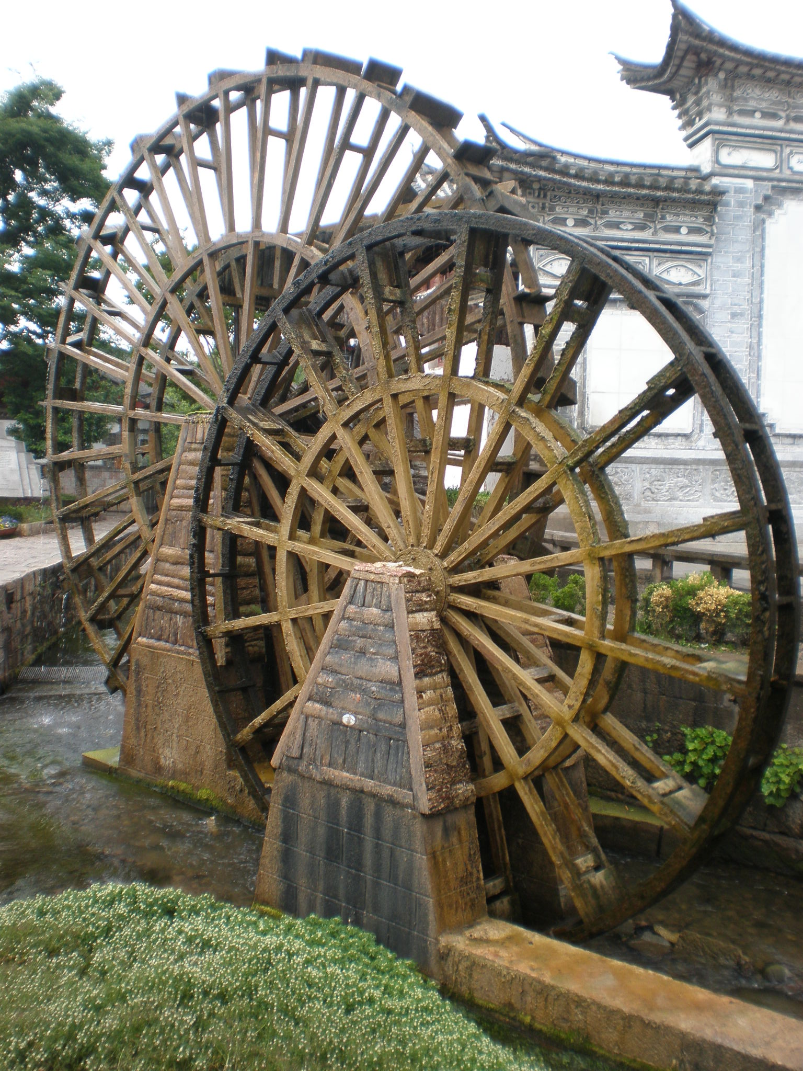
Ram pumping is a new take on an otherwise known, old technology
Ram-pumps use the kinetic energy of flowing water to pump some of that water up and away.
The essential concept had been used for centuries, in the past, in the form pumps powered by water wheels. Ram pumps are just more advanced a version of that old technology.
We can retain rainwater by making it loop through local ecosystems, and ram pumps provide the kinetic mediation in such a process.
RAM PUMPS

Slide 6
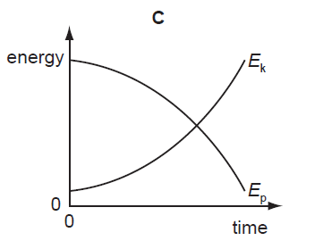
Ram pumps allow both the horizontal transport of water and and vertical elevation, which can be used as hydraulic head for hydrogeneration
Electric power [WATTS]
=
Head [vertical metres]
*
9,81
*
Flow [m³/s]
*
efficiency of the hydroelectric turbine
RAM PUMPS

Slide 7
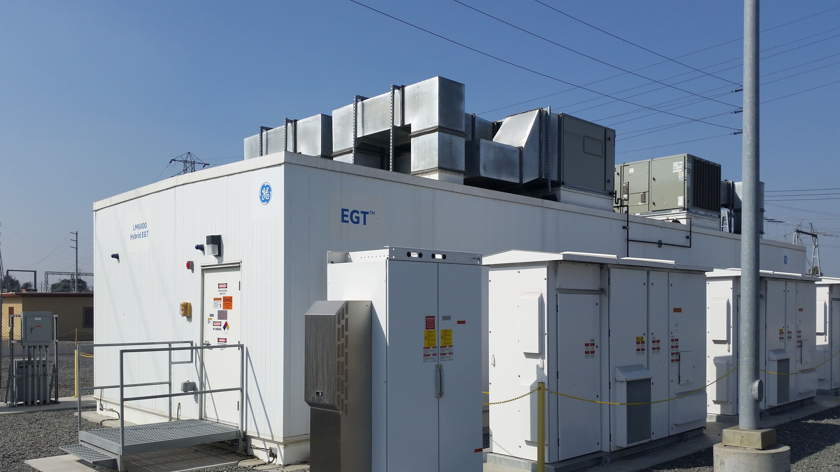
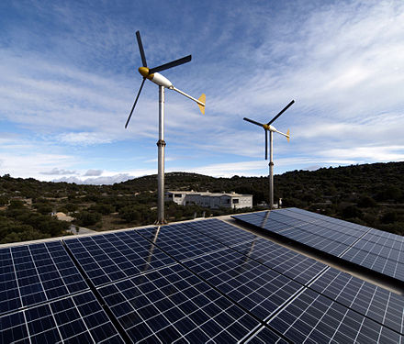
Challenges remain to overcome
Efficiency, and the capital cost of ram pumping.
Optimal use of land and combination with the existing human structures.
Storage and distribution of electricity
Combination with other renewable sources of energy

Slide 8
Challenge 1: the capital cost of ram pumping
Levelized Cost Of Energy (LCOE) for hydrogeneration ⬄ $0,05 per 1 kWh
Levelized Cost of Storage (LCOS) for Li-Ion batteries ⬄ $0,05 per 1 kWh
Estimate capital cost of ram pumps ⬄ ~ $30 per 1 kWh !!
The technological challenge consists in driving that capital cost significantly down

Slide 9
Challenge 2: use of land and combination with other structures
?
Wetlands are incompatible with farmland: they can coexist next to each other, yet they can hardly overlap.
Wetlands seem to have some capacity to overlap with urban structures. Programmes such as Sponge Cities in China give some promise in that respect.
Retention of water, and electricity are the most needed in densely populated areas, when land is the scarcest.
X

Slide 10
Challenge 3: Storage and distribution of electricity
It is rational to assume that hydroelectric turbines should be paired with some technology of energy storage technology.
Li-Ion batteries seem the most promising
Yet, we strike the same paradox:
energy is the most needed in densely populated areas,
wetlands, functionally connected to hydroelectric turbines in this concept, need a lot of settlement-free space.
It is possible that Energy Ponds are the most workable concept in the countryside or in remote peri-urban locations

Slide 11
Challenge 4: Combination with other renewable sources of energy
Wetlands take space, and RES installations, such as small wind turbines or photovoltaic, take space as well.
There might be an optimal combination of wind, PV, and wetlands in one spatial location.

Slide 12
Operational cash flows
20 metres of elevation
To the extent that Energy Ponds would live on the sales of electricity, the selling price should be at least $0,15 per kWh, to assure any overhead after the cost of generating energy (LCOE) and the cost of storing it (LCOS).
The hydrogenating capacity of Energy Ponds, without counting other possible installations (wind, PV), is pretty low: with an assumed elevation of 20 metres, the energy yield is 0,15 kW of power per 1 m³/s in terms of waterflow.
0,15 kW of electric power
1 m³/s of waterflow

Slide 13
The most valuable assets to invest in
!
RAM PUMPS
The most valuable asset, among those to be possibly acquired for Energy Ponds, is a technology of manufacturing and installing CHEAP, EFFICIENT RAM PUMPS.
The second most important type of assets are reliable legal claims on the land included in the project, with low legal risk.

